Slide 1



project 3
Dataset: Superstore Dataset
Source : Kaggle
Link : https://www.kaggle.com/datasets/vivek468/superstore-dataset-final/data
By: Wisdom Chimezie
8 January 2025

Slide 2
ANALYSES PERFORMED
Bar Plot showing profitability by state
Bar Chart Showing Most Popular Category By State
Correlation Between Sales, Profit and Discount
Comparison of Total Profit Across Regions
Analysis of Shipment Rate by Quarter
Heatmap Showing the Contribution of Customer Segments to Regional Sales and Profit

Slide 3
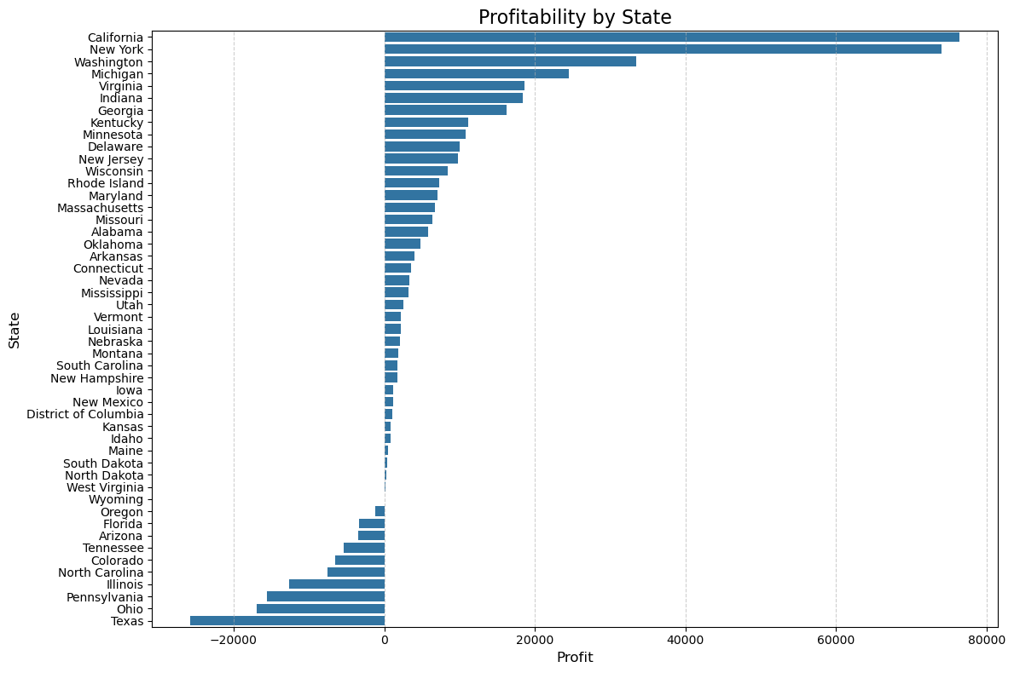
Bar Plot showing profitability by state

Slide 4
INSIGHTS
States like Texas, Ohio, Illinois that show negative profitability could be as a result of ineffective pricing or discounts, low demand or high operational cost.
For top performing states, marketing and sales effort should be consistent to continue to drive growth.

Slide 5
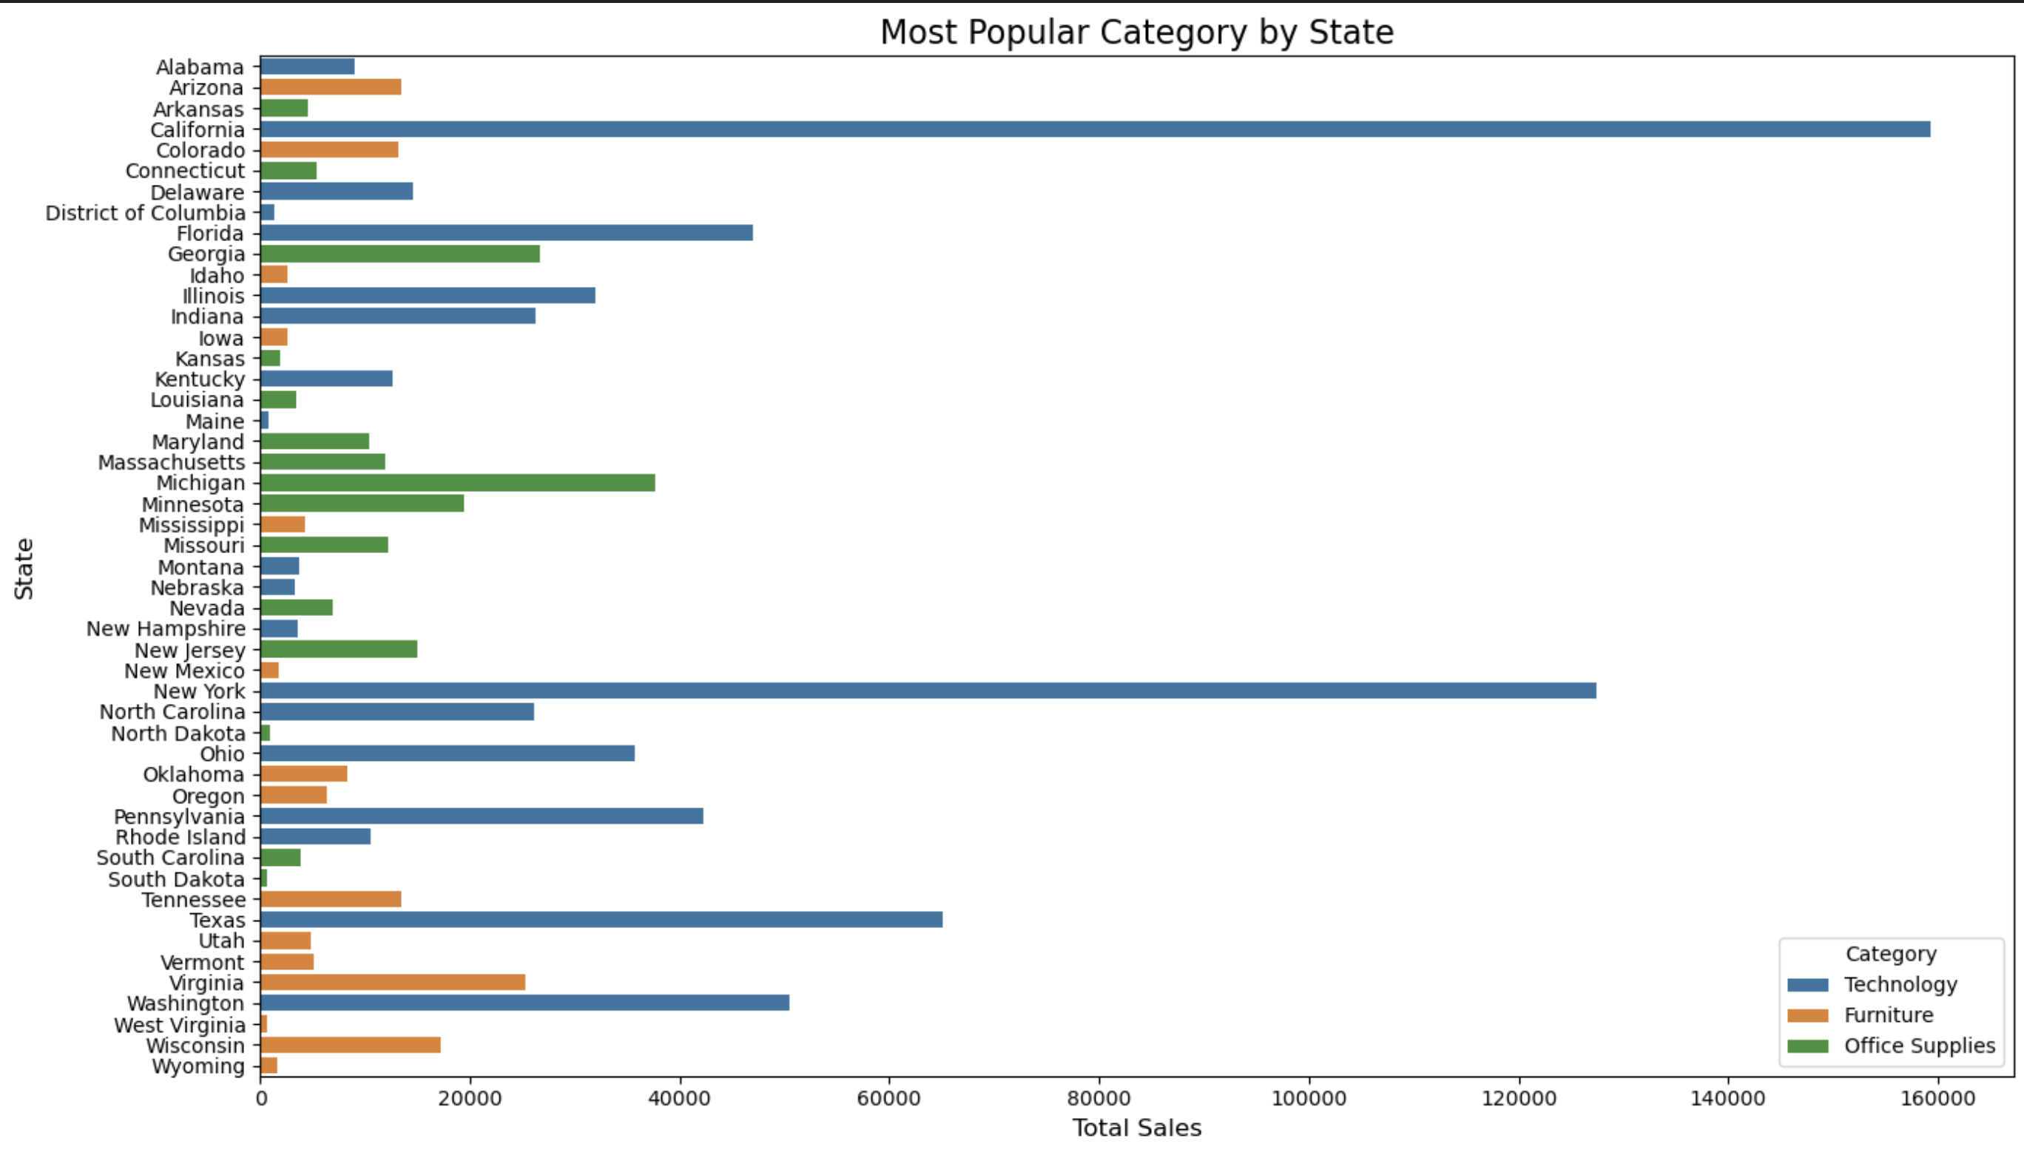
Bar Chart Showing Most Popular Category By State

Slide 6
INSIGHTS
Technology is the most popular category in most states. It shows high sales in California, New York and Texas. This could be because of the large population in these states and the presence of Tech industries due to urbanization.
There is a need to prioritize the sales of technology products in these states.

Slide 7
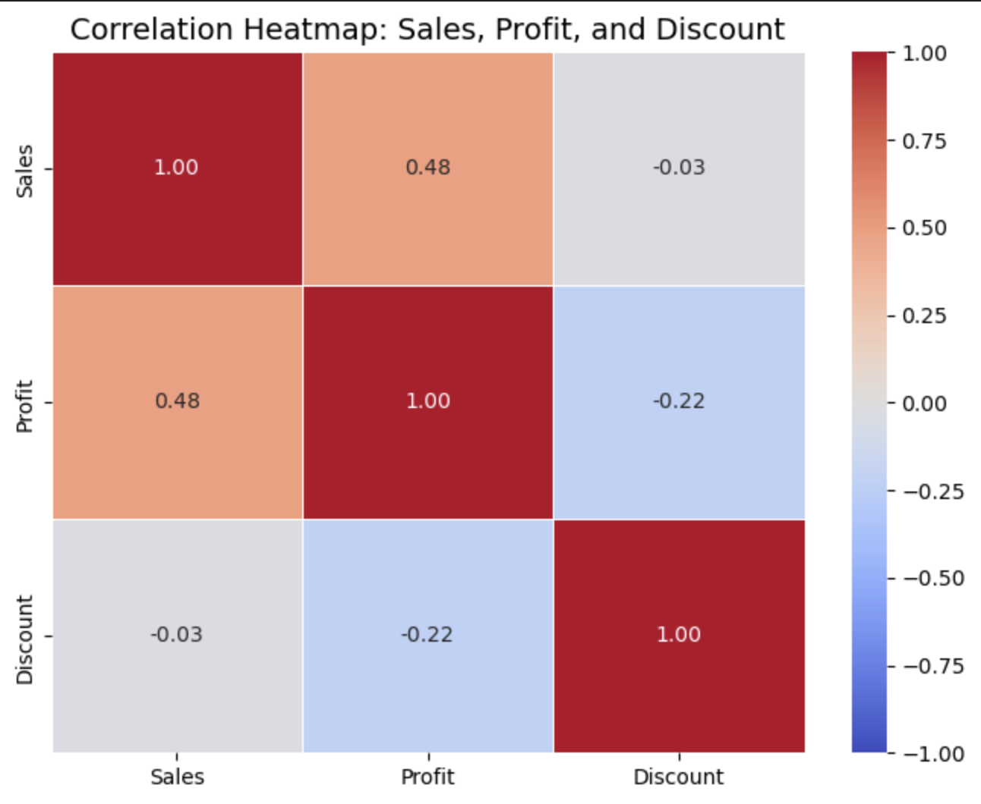
Correlation Between Sales, Profit and Discount

Slide 8
INSIGHTS
There is a moderate positive correlation between sales and profit. As sales increase, profits also tend to increase.
There is no correlation between sales and discount.
There is a weak correlation between profit and discount. As discounts increase, profits decrease slightly.
Discount should not be used as a method of boosting sales.

Slide 9
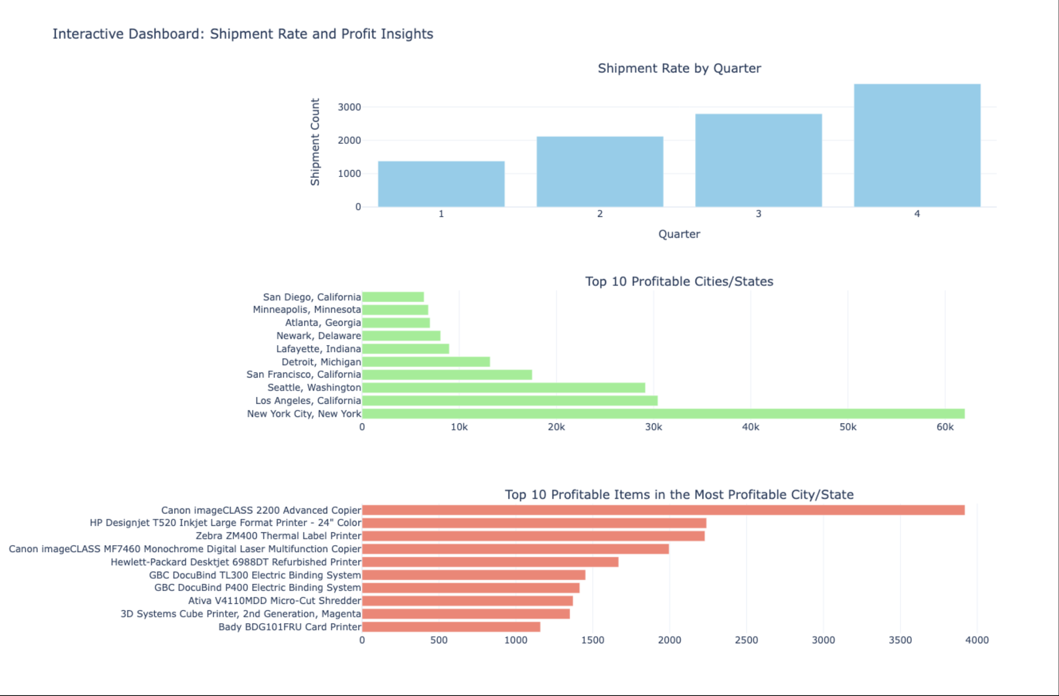
Analysis of Shipment Rate by Quarter

Slide 10
INSIGHTS
Q4 has the highest shipment rate, indicating a peak in customer demand, possibly driven by holiday seasons like Thanksgiving, Black Friday, Cyber Monday and Christmas sales.
Q1 might need promotional efforts to boost sales.
Profitable Cities/States
New York shows the most promise for the company.
California and Washington show potentials of growth, while other cities need targeted strategies to improve profitability
Profitable items in the most profitable cities
Office equipment like copiers and printers show the most profitability, indicating greater demand for this product category. This could be influenced by the presence of more companies and establishments in these cities. There is a need to promote other product categories to boost sales and profitability.

Slide 11
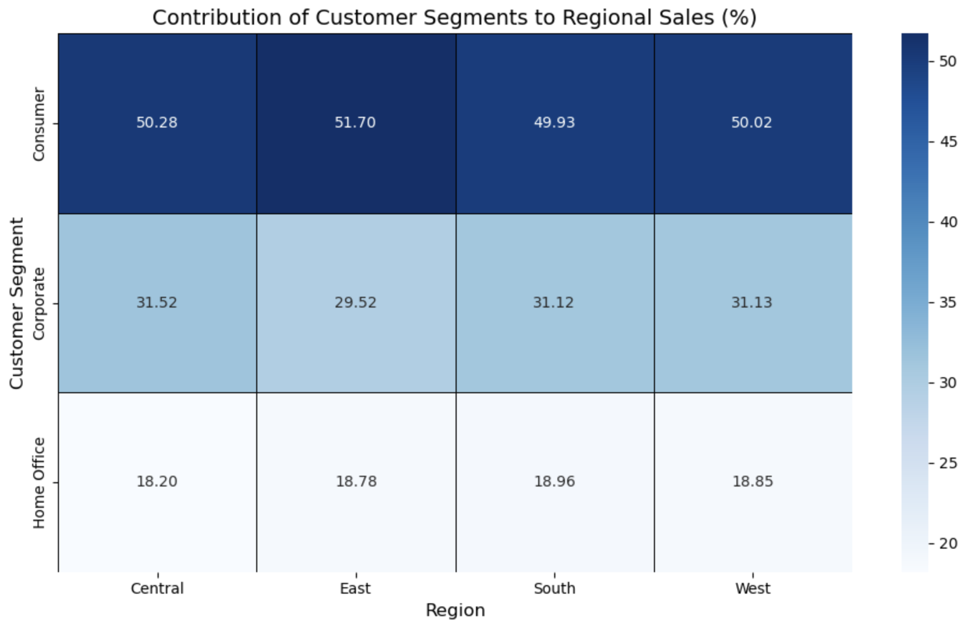
Heatmap Showing the Contribution of Customer Segments to Regional Sales

Slide 12
INSIGHTS
Sales
The consumer segment dominates sales contribution across all regions, contributing approximately 50% in every region. It is the primary driver of sales across all regions, indicating its importance as a key customer segment. The differences between the consumer segment, the corporate segment and home office segment highlights a potential opportunity to target the corporate and home office segments more effectively to increase sales.
We also see a uniform customer behavior pattern across regions.

Slide 13
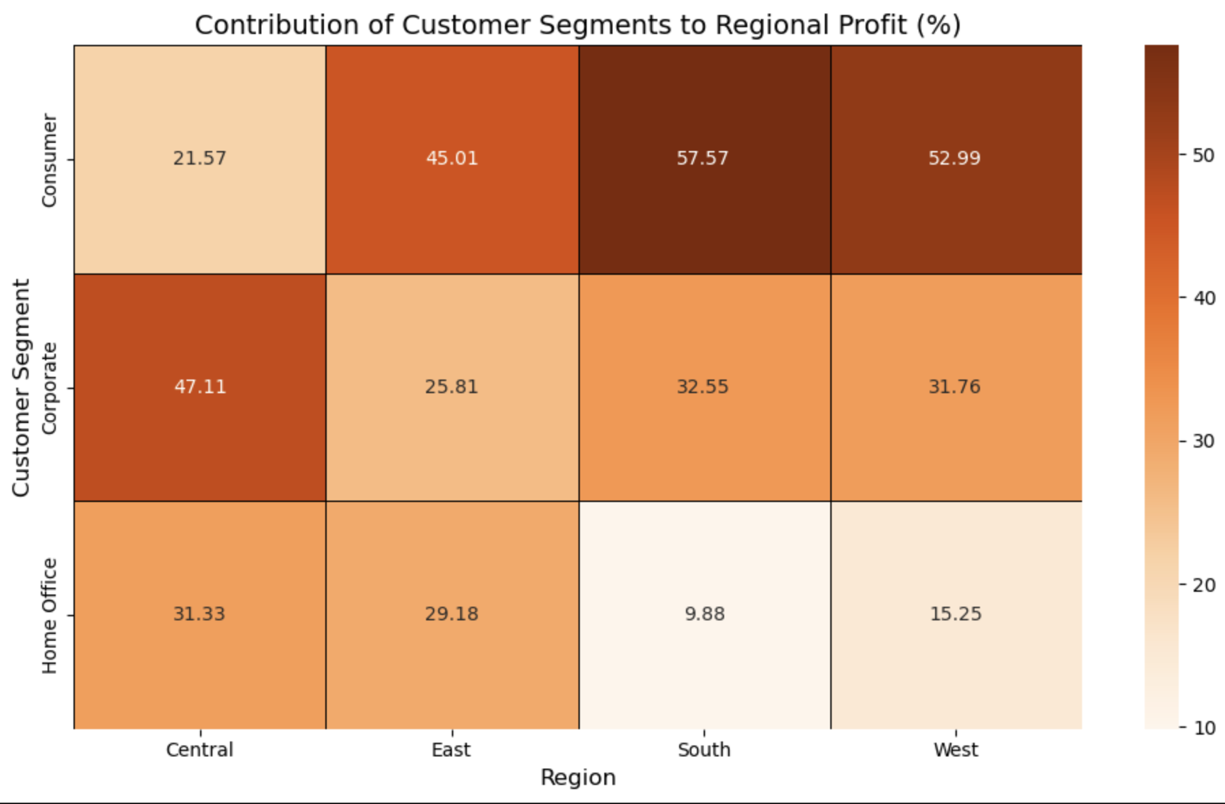
Heatmap Showing the Contribution of Customer Segments to Regional Profit

Slide 14
INSIGHTS
Profit
The Consumer segment shows the most profit in the South and West regions, suggesting these areas heavily rely on individual consumers for profitability.
The Corporate segment has a stronger performance in the central region, while the home office performs poorly in the south. This indicates an opportunity to boost profit in specific regions with targeted strategies.

Slide 15

THANK YOU

